Slide 1
Conference
European Year of Skills and Active Labour Market Policies
Barcelona, 19 - 20 October 2023

Slide 2
PRO_MOV Programme - Professional Reskilling Courses
This national scheme is part of the European initiative Reskilling 4 Employment (R4E), created by the European Round Table for Industry (ERT), a European forum for business leaders aiming to promote competitiveness and prosperity in Europe. The ERT is a high-level forum which brings together CEOs and chairs from some of Europe’s most important industrial and technology companies.
The scheme was launched in December 2021. It was promoted by Sonae, Nestlé and SAP, working closely with the public sector through the Portuguese Institute for Employment and Vocational Training (IEFP) and the Ministry of Labour, Solidarity and Social Security. The association Business Roundtable Portugal (BRP) joined the scheme, bringing with it a major influx of Portuguese companies from a wide range of sectors (including EDP, Delta Cafés, Sogrape, CUF and Hovione).
7 laboratories
Industry | Nestlé
Agriculture | Sogrape
Digital | SAP
Sales excellence | Delta
Green jobs | EDP
Healthcare | CUF, Hovione
Business Intelligence | Worten

Slide 3
PRO_MOV Programme - Professional Reskilling Courses
Professional reskilling for unemployed or underemployed persons (jobs/professions at risk) with skills gaps or lack of qualifications or experience:
adaptation of qualifications to meet the emerging demands of the labour market, new jobs and jobs which require new professional skills in an increasingly globalised, competitive and constantly changing context.
Training courses tailored to existing needs, involving the participation of companies and trainers from the IEFP as technical specialists/experts.
Training courses lasting no longer than 1100 hours in total (about 9 months), incorporating two training components:
classroom-based training with a standard duration of 6 months (which may also take place in an office or laboratory);
workplace-based training with a standard duration of 3 months.

Slide 4
PRO_MOV Programme - Professional Reskilling Courses
Social assistance provided to students by the IEFP during classroom-based training and workplace-based training, specifically:
training assistance (with a maximum monthly value of 50 % or 65 % of the social assistance baseline rate, depending on the student’s situation);
food (equal to the value established for workers performing public functions, in the form of a subsidy or aid in kind);
travel (total expenditure on public transport or a subsidy/aid in kind with a maximum monthly value of 15 % of the social assistance baseline rate);
reception (with a maximum monthly value of 50 % of the social assistance baseline rate);
accommodation (with a maximum monthly value of 30 % of the social assistance baseline rate, in the form of a subsidy or aid in kind).
With respect to workplace-based training, in addition to the assistance outlined above, the company hosting the student provides a social assistance supplement at a minimum amount of 50 % of the social assistance baseline rate.

Slide 5
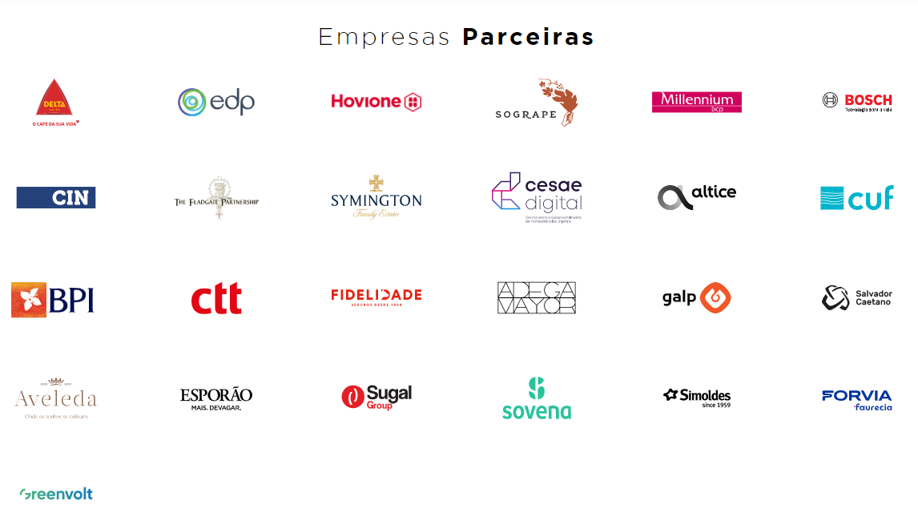
PRO_MOV Programme - Professional Reskilling Courses
Cooperation and partnerships with benchmark companies help:
generate synergies offering a more relevant response to the demands of both individuals and organisations, sharing specialised expertise in particular areas of activity;
drive greater effectiveness and efficiency in lifelong learning trajectories and in responding to the challenges of the labour market and demand for new skills;
improve the social, personal and technical skills of unemployed people or those at risk of unemployment who are registered with the IEFP, boosting unemployed workers’ reintegration into the labour market or enabling employed workers at risk of unemployment to preserve their jobs;
promote reskilling for unemployed people in areas of activity where there is a lack of qualified human resources, offering a double benefit with their reintegration, whenever this is possible in the area of training involved in the reskilling process;
establish a benchmark figure for professional reintegration into the labour market of an average of 80 % of students who are unemployed at the beginning of the programme and who successfully complete their training course.
https://stream.mux.com/02OYH0200LlMMQ8OWGrxBB4jV7B4jOsj1gA/high.mp4

Slide 6
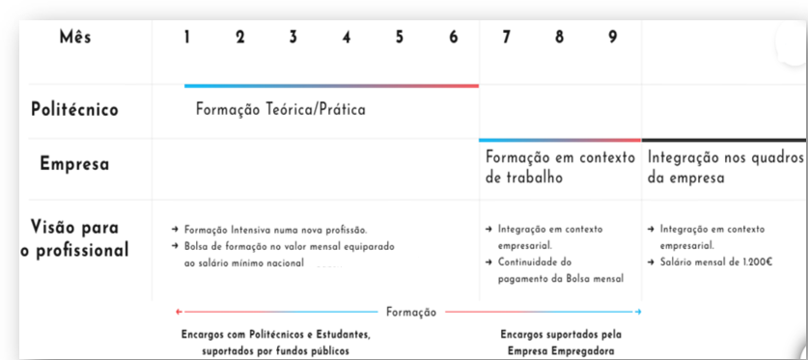
UPskill Programme - Digital Skills and Jobs
Retraining of employed, unemployed or underemployed workers, equipping them to work in various areas of the Information and Communications Technology (ICT) sector which are identified by collaborating companies as areas where job vacancies will arise.
Training courses lasting an average of 9 months, designed by higher education institutions and companies, and integrating 2 training components:
classroom-based theory training with a standard duration of 6 months;
workplace-based training with a standard duration of 3 months.
Social assistance provided by the IEFP during classroom-based training and by the companies during workplace-based training, specifically:
training assistance (equivalent to the national minimum wage);
food (equal to the value established for workers performing public functions).

Slide 7
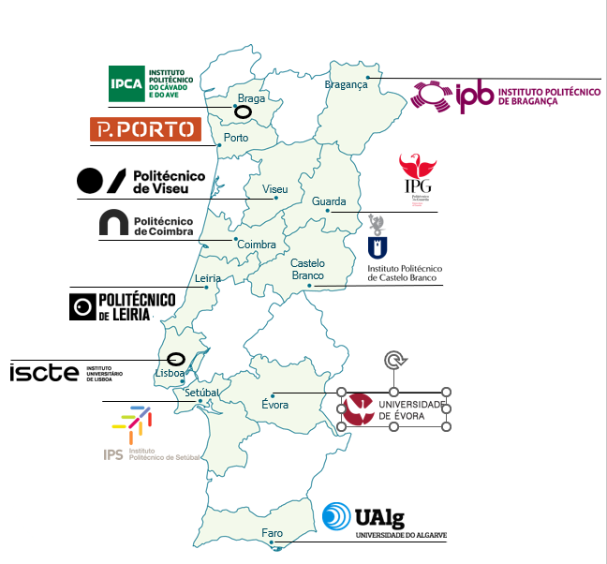
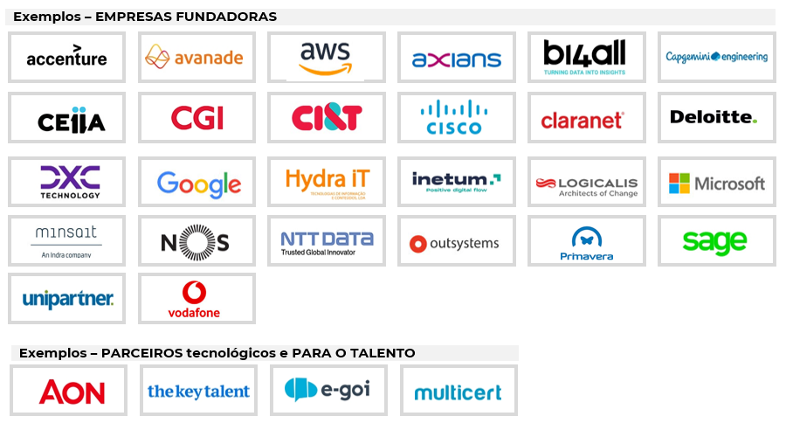
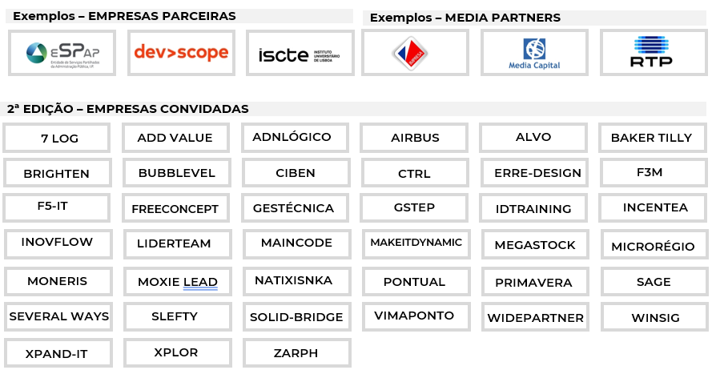
UPskill Programme - Digital Skills and Jobs
Based on cooperation and collaboration, where training and qualifications are designed to meet existing and emerging training needs, particularly those of national enterprises related to the digital economy, as well as those of individuals wishing to boost their salary and employment opportunities.
An association established in collaboration between the State (which finances it through the IEFP), higher education institutions (represented by 12 universities and polytechnical institutions), responsible for the training of human resources, and companies (represented by the APDC digital business community) that commit to hiring 80% of the students who successfully finish their training, with a guaranteed salary of 1,200 euros.
Example courses:
OutSystems Programming; JAVA Programming; Cloud AWS; Frontend (Angular); Data Warehouse/BI; Robotic Process Automation (RPA); Appian; .NET Programming; Azure Cloud Computing; CRM; Power Platform; Cybersecurity Network Operations.

Slide 8
UPskill Programme - Digital Skills and Jobs
The 1st iteration, rolled out in 2020, received applications from over 5,300 candidates, of which 430 students were selected for 26 training actions that took place in 7 locations.
The 2nd iteration, launched in October 2021, was carried out over two separate cycles. Almost 800 students were selected for 50 training actions that took place in 11 locations across the country, involving more than 60 companies. In general terms, this should result in the creation of more than 800 jobs in the digital area.
The 3rd iteration is currently ongoing.
The programme impacts on:
unemployment/underemployment - 80% of the people who successfully completed both the 1st and 2nd iterations were hired;
labour market dynamism - just 6 months after their recruitment, some of the students were hired by other companies at a higher salary, while the number of companies wishing to join the programme doubled.
UPskill Companies | 3rd iteration - YouTube
UPskill Candidates | 3rd iteration - YouTube
https://youtu.be/SqU92HeidFw

